Slide 1
Chapter 2: Operating-System Structures

Slide 2
Operating System Services
One set of operating-system services provides functions that are helpful to the user:
  User interface - Almost all operating systems have a user interface (UI)
    Varies between Command-Line (CLI), Graphics User Interface (GUI), Batch
  Program execution - The system must be able to load a program into memory and to run that program, end execution, either normally or abnormally (indicating error)
  I/O operations - A running program may require I/O, which may involve a file or an I/O device.
  File-system manipulation - The file system is of particular interest. Obviously, programs need to read and write files and directories, create and delete them, search them, list file Information, permission management.

Slide 3
Operating System Services (Cont.)
One set of operating-system services provides functions that are helpful to the user (Cont):
  Communications – Processes may exchange information, on the same computer or between computers over a network
    Communications may be via shared memory or through message passing (packets moved by the OS)
  Error detection – OS needs to be constantly aware of possible errors
    May occur in the CPU and memory hardware, in I/O devices, in user program
    For each type of error, OS should take the appropriate action to ensure correct and consistent computing
    Debugging facilities can greatly enhance the user’s and programmer’s abilities to efficiently use the system

Slide 4
Operating System Services (Cont.)
Another set of OS functions exists for ensuring the efficient operation of the system itself via resource sharing
  Resource allocation - When multiple users or multiple jobs running concurrently, resources must be allocated to each of them
    Many types of resources - Some (such as CPU cycles,mainmemory, and file storage) may have special allocation code, others (such as I/O devices) may have general request and release code.
  Accounting - To keep track of which users use how much and what kinds of computer resources
  Protection and security - The owners of information stored in a multiuser or networked computer system may want to control use of that information, concurrent processes should not interfere with each other
    Protection involves ensuring that all access to system resources is controlled
    Security of the system from outsiders requires user authentication, extends to defending external I/O devices from invalid access attempts
    If a system is to be protected and secure, precautions must be instituted throughout it. A chain is only as strong as its weakest link.

Slide 5
User Operating System Interface - CLI
CLI allows direct command entry
    Sometimes implemented in kernel, sometimes by systems program
    Sometimes multiple flavors implemented – shells
    Primarily fetches a command from user and executes it
      Sometimes commands built-in, sometimes just names of programs
        If the latter, adding new features doesn’t require shell modification

Slide 6
User Operating System Interface - GUI
User-friendly desktop metaphor interface
  Usually mouse, keyboard, and monitor
  Icons represent files, programs, actions, etc
  Various mouse buttons over objects in the interface cause various actions (provide information, options, execute function, open directory (known as a folder)
  Invented at Xerox PARC
Many systems now include both CLI and GUI interfaces
  Microsoft Windows is GUI with CLI “command” shell
  Apple Mac OS X as “Aqua” GUI interface with UNIX kernel underneath and shells available
  Solaris is CLI with optional GUI interfaces (Java Desktop, KDE)

Slide 7
System Calls
Programming interface to the services provided by the OS
Typically written in a high-level language (C or C++)
Mostly accessed by programs via a high-level Application Program Interface (API) rather than direct system call use
Three most common APIs are Win32 API for Windows, POSIX API for POSIX-based systems (including virtually all versions of UNIX, Linux, and Mac OS X), and Java API for the Java virtual machine (JVM)

Slide 8

Example of System Calls
System call sequence to copy the contents of one file to another file

Slide 9
System Call Implementation
Typically, a number associated with each system call
  System-call interface maintains a table indexed according to these numbers
The system call interface invokes intended system call in OS kernel and returns status of the system call and any return values
The caller need know nothing about how the system call is implemented
  Just needs to obey API and understand what OS will do as a result call
  Most details of OS interface hidden from programmer by API
    Managed by run-time support library (set of functions built into libraries included with compiler)

Slide 10

API – System Call – OS Relationship

Slide 11
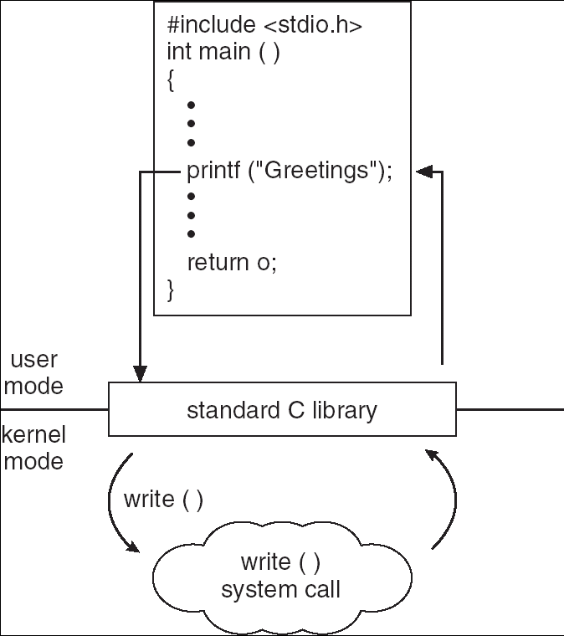
Standard C Library Example
C program invoking printf() library call, which calls write() system call

Slide 12
Types of System Calls
Process control
File management
Device management
Information maintenance
Communications

Slide 13

FreeBSD Running Multiple Programs

Slide 14
System Programs
System programs provide a convenient environment for program development and execution. The can be divided into:
  File manipulation
  Status information
  File modification
  Programming language support
  Program loading and execution
  Communications
  Application programs
Most users’ view of the operation system is defined by system programs, not the actual system calls

Slide 15
System Programs
Provide a convenient environment for program development and execution
  Some of them are simply user interfaces to system calls; others are considerably more complex
File management - Create, delete, copy, rename, print, dump, list, and generally manipulate files and directories
Status information
  Some ask the system for info - date, time, amount of available memory, disk space, number of users
  Others provide detailed performance, logging, and debugging information
  Typically, these programs format and print the output to the terminal or other output devices
  Some systems implement a registry - used to store and retrieve configuration information

Slide 16
System Programs (cont’d)
File modification
  Text editors to create and modify files
  Special commands to search contents of files or perform transformations of the text
Programming-language support - Compilers, assemblers, debuggers and interpreters sometimes provided
Program loading and execution- Absolute loaders, relocatable loaders, linkage editors, and overlay-loaders, debugging systems for higher-level and machine language
Communications - Provide the mechanism for creating virtual connections among processes, users, and computer systems
  Allow users to send messages to one another’s screens, browse web pages, send electronic-mail messages, log in remotely, transfer files from one machine to another

Slide 17
Operating System Design and Implementation
Design and Implementation of OS not “solvable”, but some approaches have proven successful
Internal structure of different Operating Systems can vary widely
Start by defining goals and specifications
Affected by choice of hardware, type of system
User goals and System goals
  User goals – operating system should be convenient to use, easy to learn, reliable, safe, and fast
  System goals – operating system should be easy to design, implement, and maintain, as well as flexible, reliable, error-free, and efficient

Slide 18
Simple Structure
MS-DOS – written to provide the most functionality in the least space
  Not divided into modules
  Although MS-DOS has some structure, its interfaces and levels of functionality are not well separated

Slide 19

MS-DOS Layer Structure

Slide 20
Layered Approach
The operating system is divided into a number of layers (levels), each built on top of lower layers. The bottom layer (layer 0), is the hardware; the highest (layer N) is the user interface.
With modularity, layers are selected such that each uses functions (operations) and services of only lower-level layers

Slide 21

Layered Operating System

Slide 22
UNIX
UNIX – limited by hardware functionality, the original UNIX operating system had limited structuring. The UNIX OS consists of two separable parts
  Systems programs
  The kernel
    Consists of everything below the system-call interface and above the physical hardware
    Provides the file system, CPU scheduling, memory management, and other operating-system functions; a large number of functions for one level

Slide 23

UNIX System Structure

Slide 24

Mac OS X Structure

Slide 25
Modules
Most modern operating systems implement kernel modules
  Uses object-oriented approach
  Each core component is separate
  Each talks to the others over known interfaces
  Each is loadable as needed within the kernel
Overall, similar to layers but with more flexible

Slide 26

Solaris Modular Approach

Slide 27
Virtual Machines
A virtual machine takes the layered approach to its logical conclusion. It treats hardware and the operating system kernel as though they were all hardware
A virtual machine provides an interface identical to the underlying bare hardware
The operating system creates the illusion of multiple processes, each executing on its own processor with its own (virtual) memory

Slide 28
Virtual Machines (Cont.)
The resources of the physical computer are shared to create the virtual machines
  CPU scheduling can create the appearance that users have their own processor
  Spooling and a file system can provide virtual card readers and virtual line printers
  A normal user time-sharing terminal serves as the virtual machine operator’s console

Slide 29

Virtual Machines (Cont.)
(a) Nonvirtual machine (b) virtual machine
Non-virtual Machine
Virtual Machine

Slide 30
Virtual Machines (Cont.)
The virtual-machine concept provides complete protection of system resources since each virtual machine is isolated from all other virtual machines. This isolation, however, permits no direct sharing of resources.
A virtual-machine system is a perfect vehicle for operating-systems research and development. System development is done on the virtual machine, instead of on a physical machine and so does not disrupt normal system operation.
The virtual machine concept is difficult to implement due to the effort required to provide an exact duplicate to the underlying machine

Slide 31

The Java Virtual Machine

Slide 32
End of Chapter 2

